Slide 1
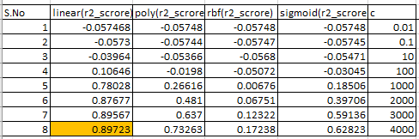
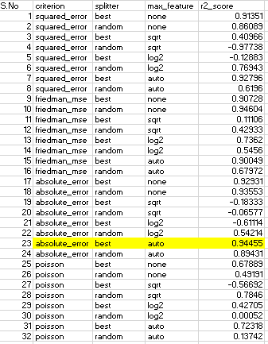
Comparing with the two models: Decision tree algorithm performed well based on r2_score value.
Decision TreeRegressor:
SVR :

